Slide 1
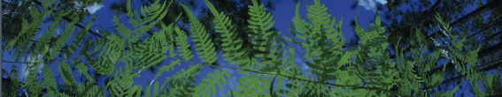



Georeferencing Overview
University of Florida
Created by Blaine Marchant, Grant Godden, and Charlotte Germain-Aubrey
BiotaPhy

Slide 2
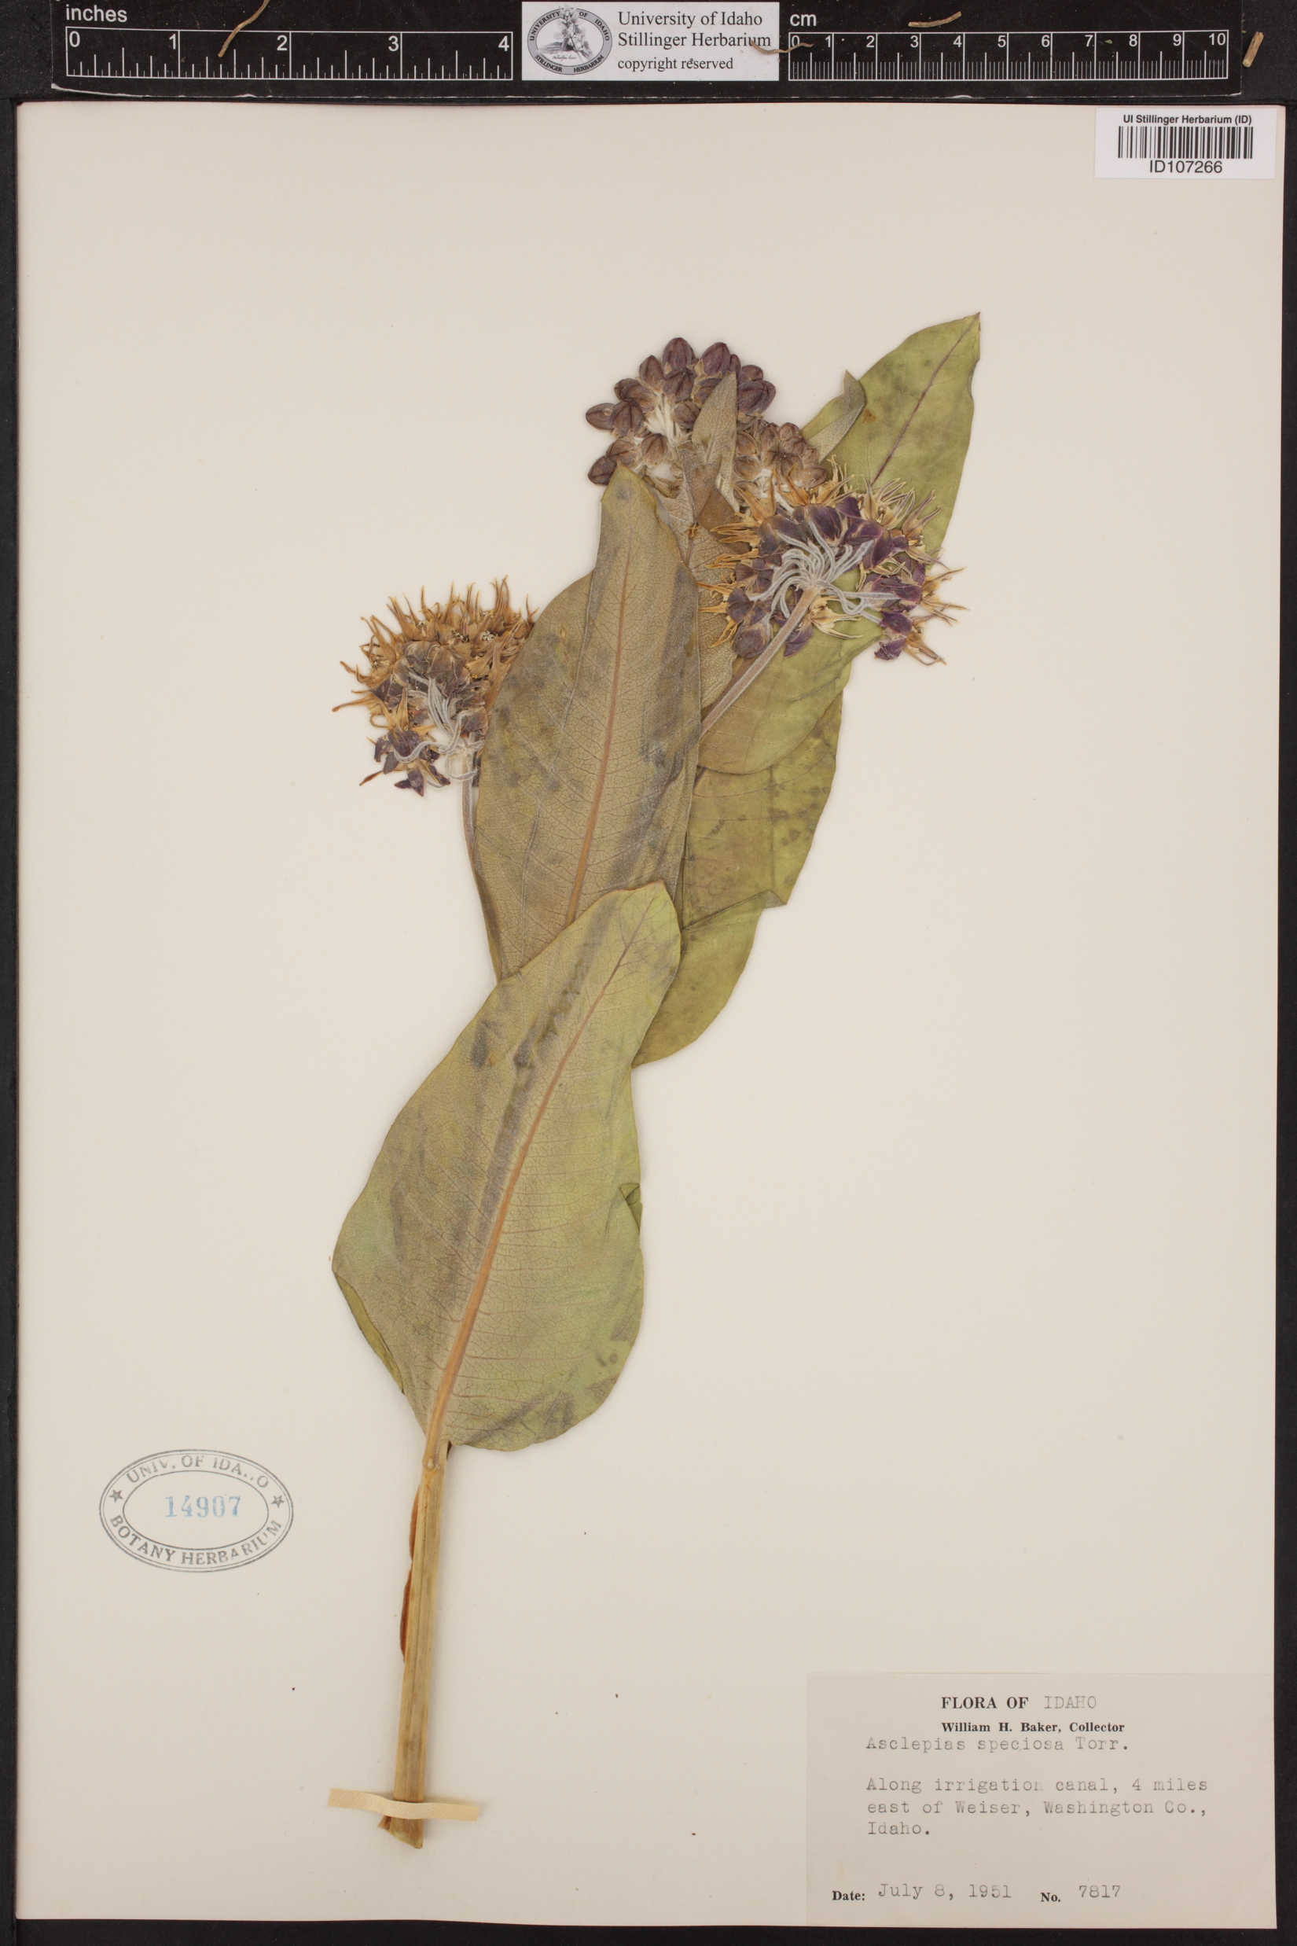
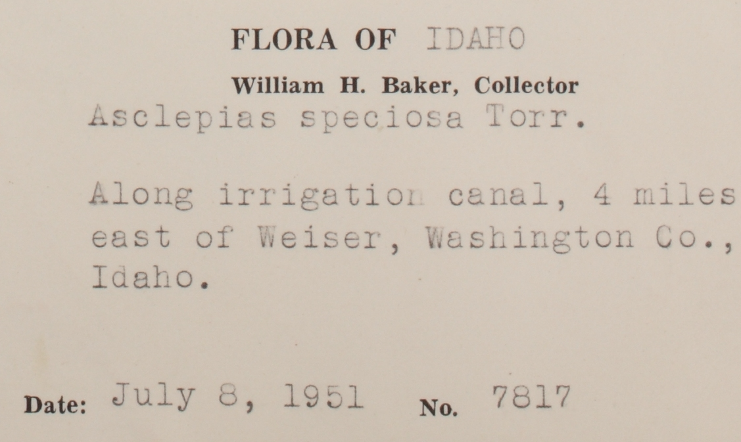
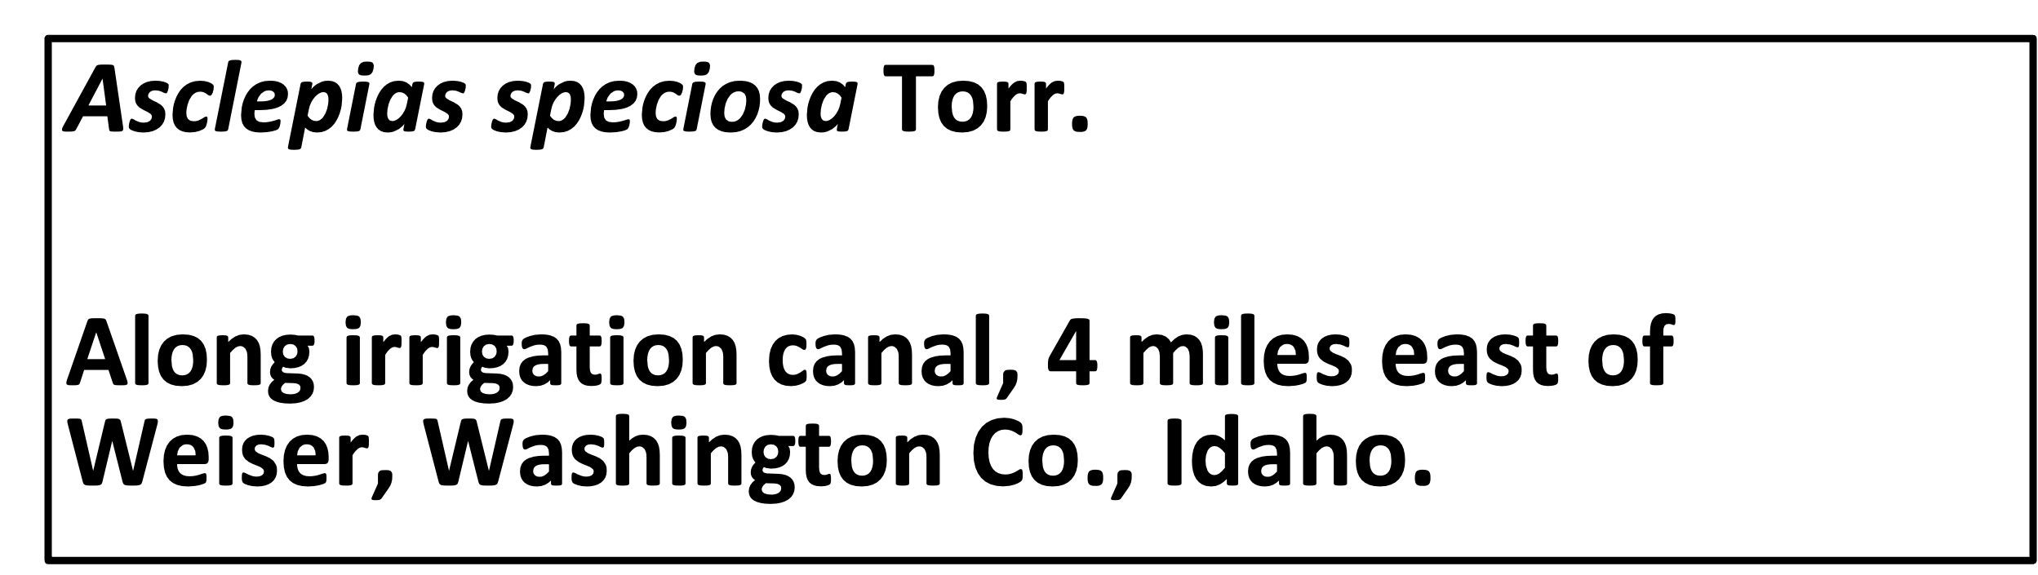
What is a georeference?
https://www.pnwherbaria.org/images/jpeg.php?Image=ID107266.jpg

Slide 3
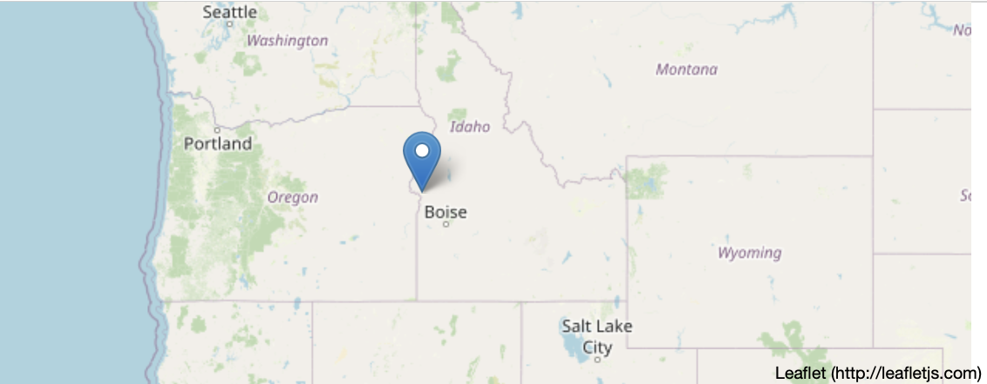
What is a georeference?

Slide 4
What is a georeference?
A numerical description of a
place that can be mapped

Slide 5
What is a georeference?
44.23, -116.88
A numerical description of a
place that can be mapped

Slide 6
What is a georeference?
44.23, -116.88

Slide 7
Why georeference?
Add more occurrences to a data set
Correct geographic and specimen identification data = dependable occurrence record
Provide uncertainty data, which allow points to be evaluated regarding fitness for research applications and the resulting quality of output

Slide 8
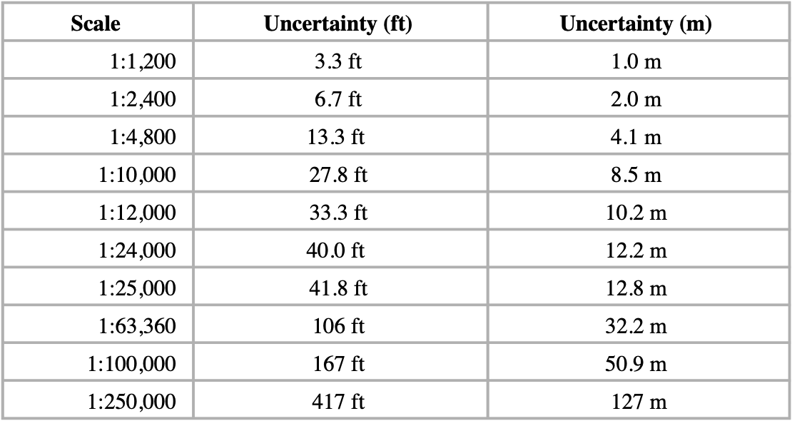
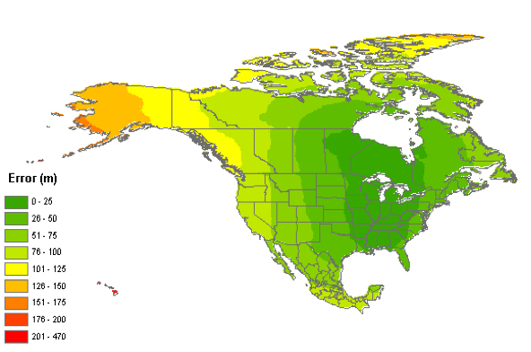
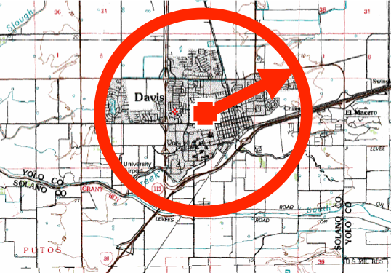
Sources of uncertainty
20° 30’ N 112° 36’ W
Coordinate uncertainty
Map scale
GPS accuracy
Unknown datum
Imprecision in direction measurements
Imprecision in distance measurements
Extent of locality

Slide 9
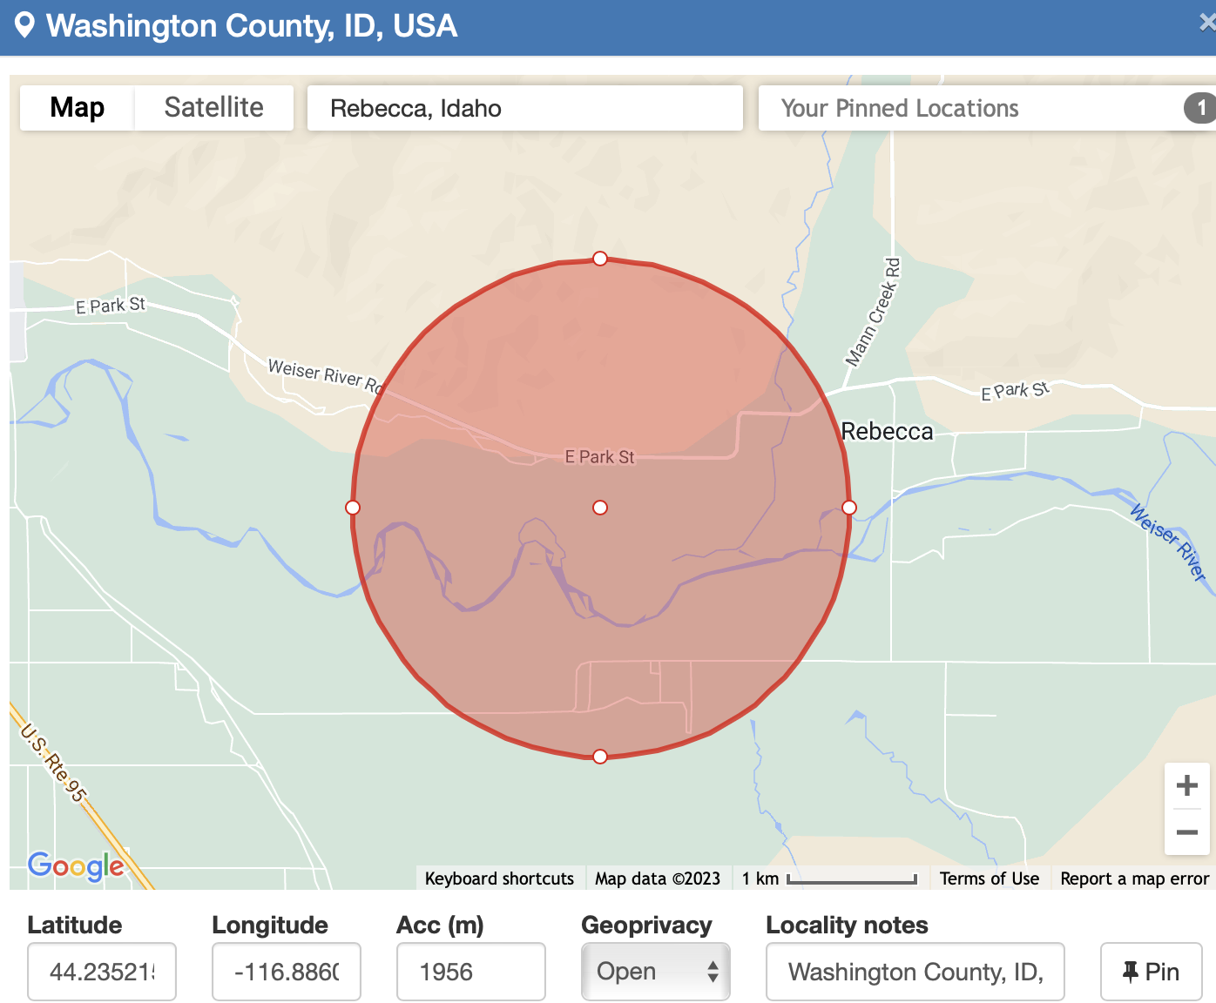
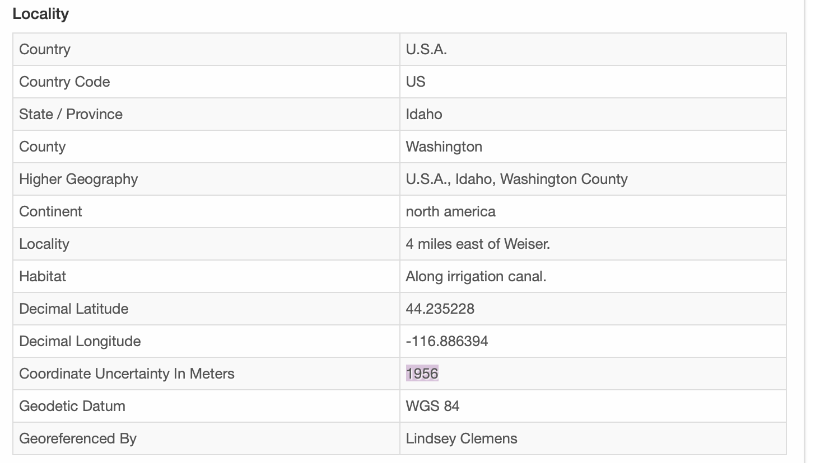

Coordinate uncertainty
Coordinate Uncertainty in Meters: 1956 m

Slide 10
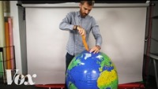
Map scale

Slide 11
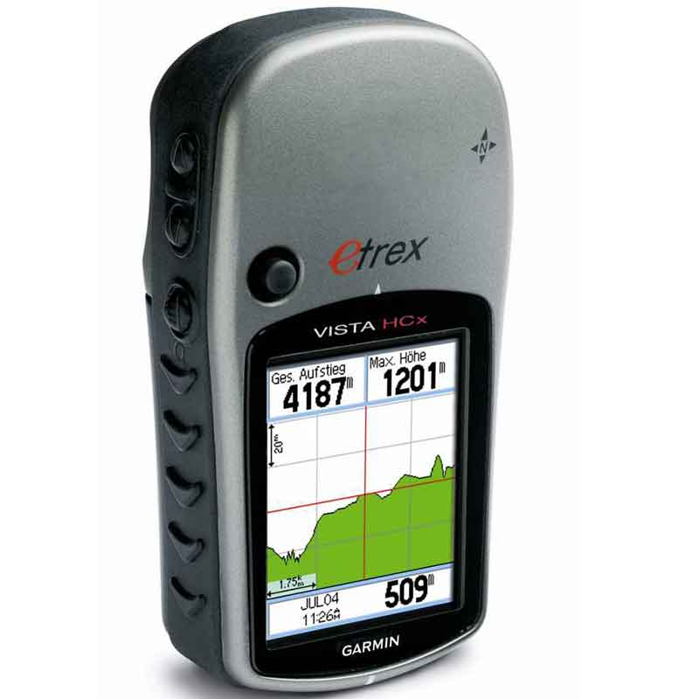
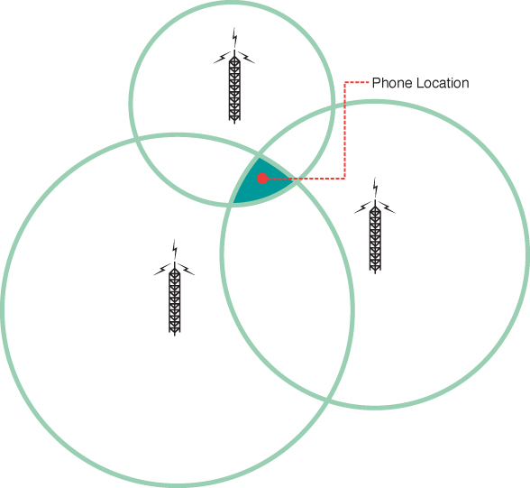
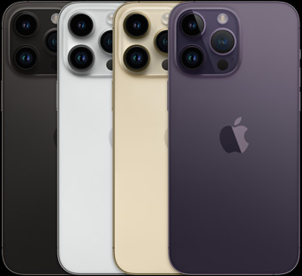
GPS accuracy
Images left to right urls: https://www.outdoorsgeek.com/product/garmin-etrex-vista-cx-handheld-gps-rental/, https://www.apple.com/iphone-14-pro/specs/, https://www.oreilly.com/api/v2/epubs/9780133383959/files/graphics/17fig02.jpg
Notes:
Historically, no GPS. So descriptions were needed!

Slide 12
Datum
What is a datum?
A geodetic datum is an abstract coordinate system with a reference surface (such as sea level) that serves to provide known locations to begin surveys and create maps. In this way, datums act similar to starting points when you give someone directions.
Geodetic datum
A model of the Earth used for geodetic calculations (related to Earth’s figure, orientation, and gravity). A geodetic datum describes the size, shape, origin, and orientation of a coordinate system for mapping the surface of the Earth.
https://oceanservice.noaa.gov/facts/datum.html#:~:text=A%20geodetic%20datum%20is%20an,when%20you%20give%20someone%20directions.

Slide 13
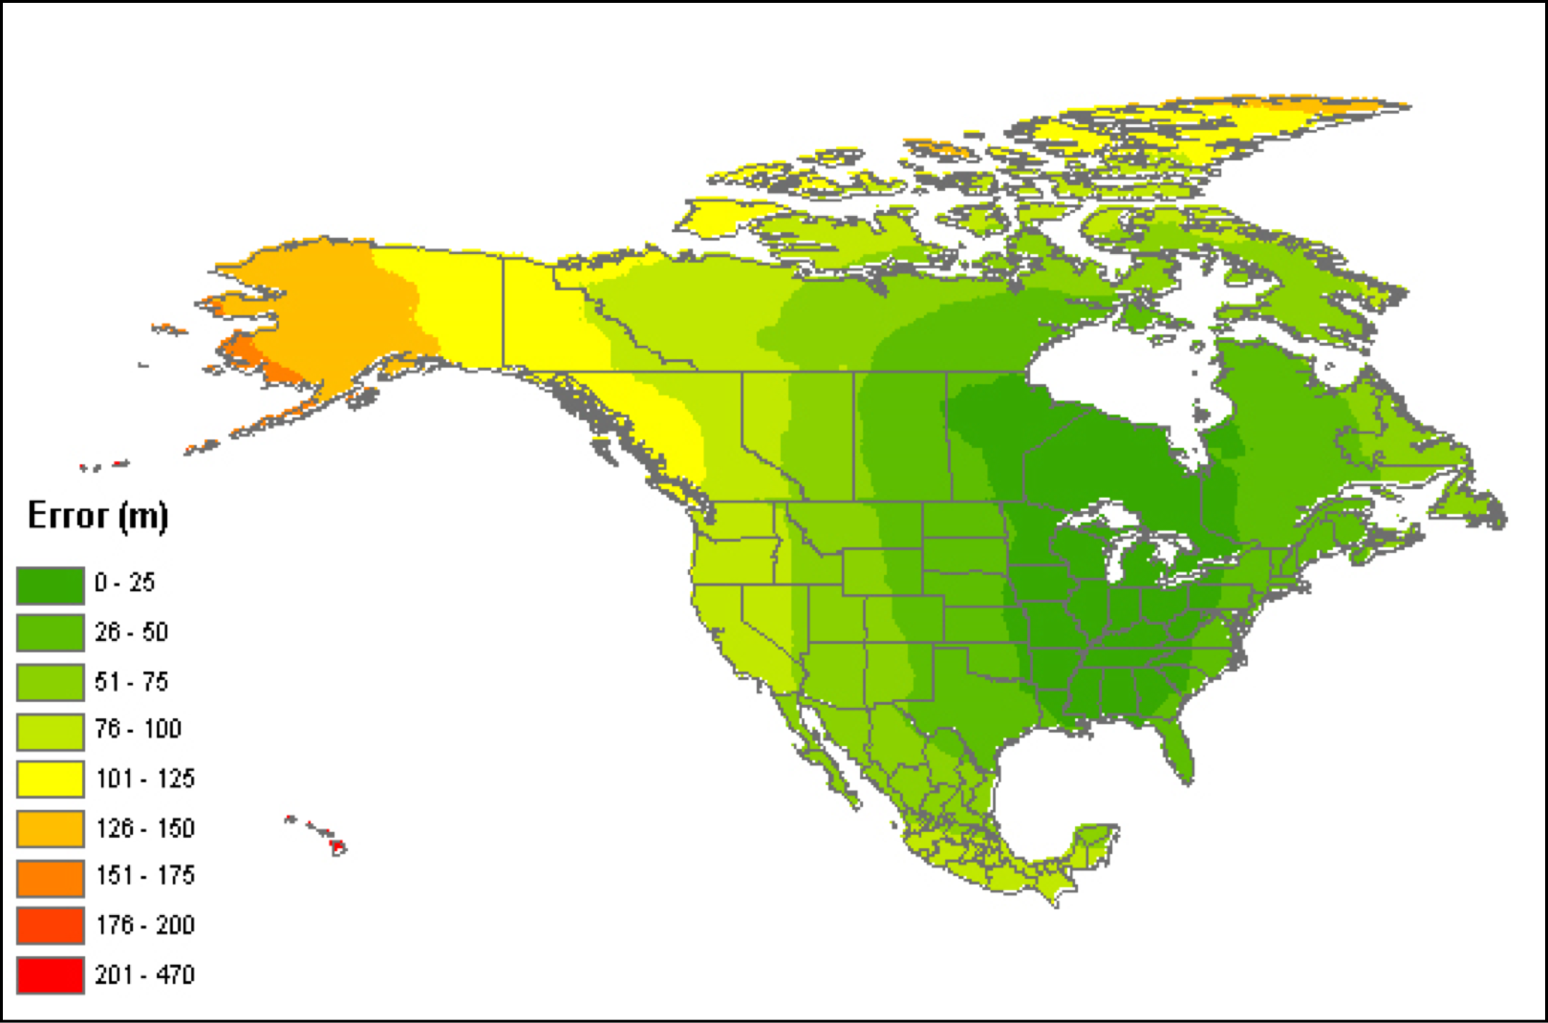
Datum uncertainty
Error assuming NAD27 vs NAD83 or WGS84
Notes:
The reference specifications of a measurement system.

Slide 14
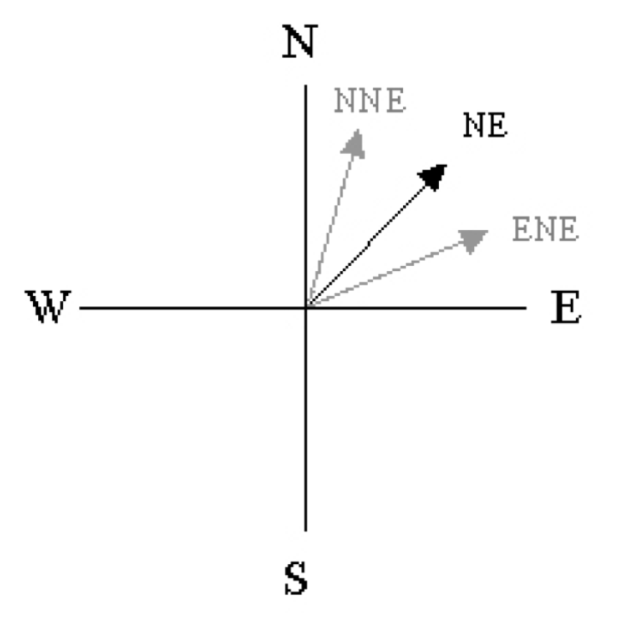
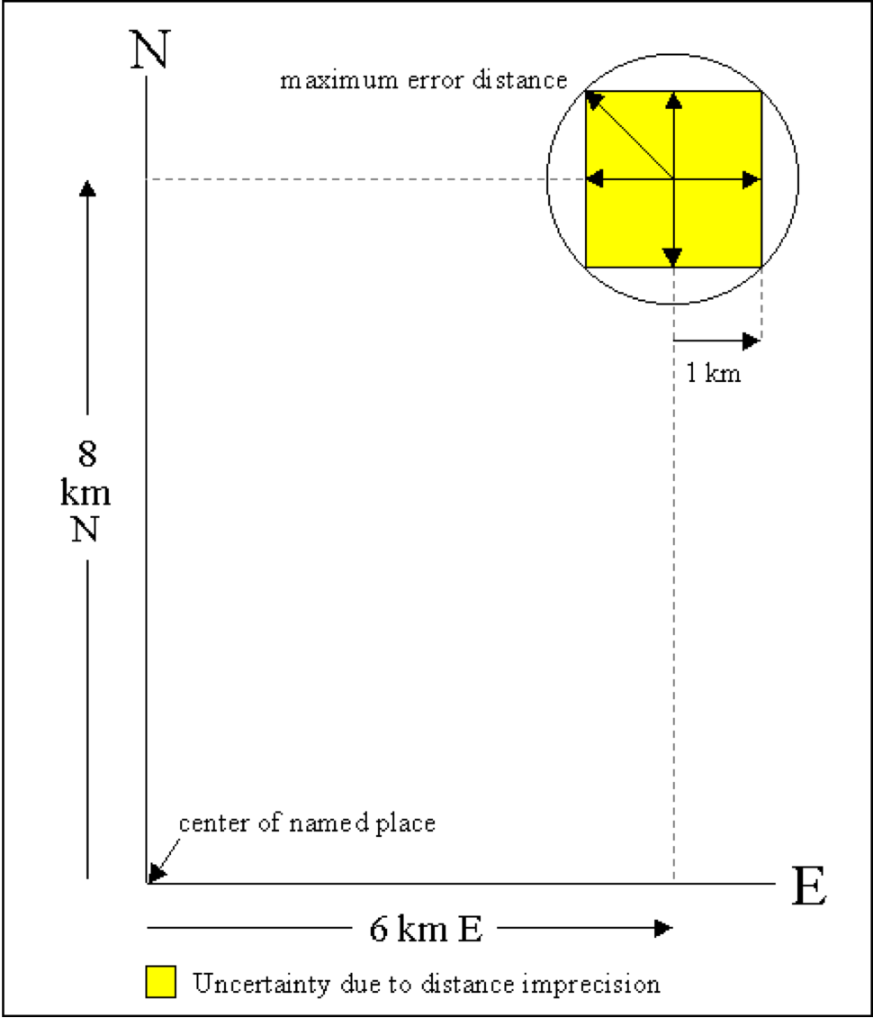
Direction and Distance measurement uncertainty
N > NE > ENE
Notes:
N > NE can be anywhere in that quadrant. The more specific the better! You may be able to follow along the road that had the directions. BUt very difficult to put on a map.
6km or 6miles - might be 5.8 or 6.2 -we tend to round. Less percision and less accuracy!
As time goes by, barriers might change. Does it mean then or now?

Slide 15
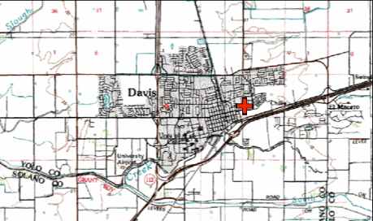
Extent of locality uncertainty
“Davis, Yolo County, CA”
Point Method
38.5463, -121.7425

Slide 16
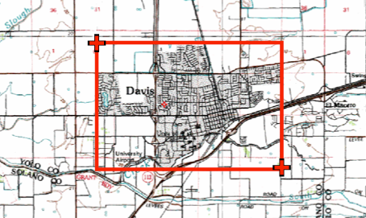
Extent of locality uncertainty
“Davis, Yolo County, CA”
Bounding-Box Method
38.5486, -121.7542
38.545, -121.7394

Slide 17
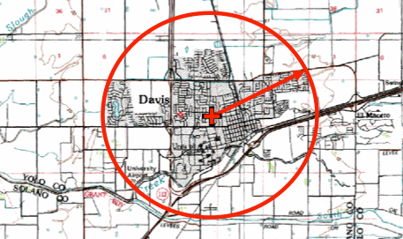
Extent of locality uncertainty
“Davis, Yolo County, CA”
Point-Radius Method
38.5468, -121.7469
Uncertainty radius: 8325 meters
Notes:
Uncertainty radius associated with point

Slide 18
Extent of locality uncertainty
“Davis, Yolo County, CA”
Note the uncertainty! If greater than the size of your variable layers, throw the locality away!
Point-Radius Method
38.5468, -121.7469
Uncertainty radius: 8325 meters
Notes:
This example uses a 30 second resolution variable layer (1 km) uncertainty is greater than resolution in this case, so it’s best to just toss this point

Slide 19
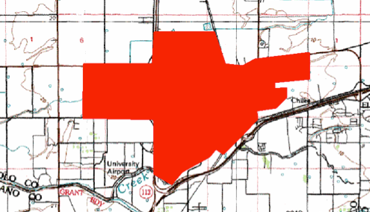
Extent of locality uncertainty
“Davis, Yolo County, CA”
Shape Method

Slide 20
Sources of Uncertainty
20° 30’ N 112° 36’ W
Coordinate uncertainty
Map scale
GPS accuracy
Unknown datum
Imprecision in direction measurements
Imprecision in distance measurements
Extent of locality

Slide 21
What is an ideal georeference?

Slide 22
What is an ideal georeference?
A numerical description of a
place that can be mapped

Slide 23
What is an ideal georeference?
A numerical description of a
place that can be mapped
and that describes the spatial
extent of a locality and its associated uncertainties

Slide 24
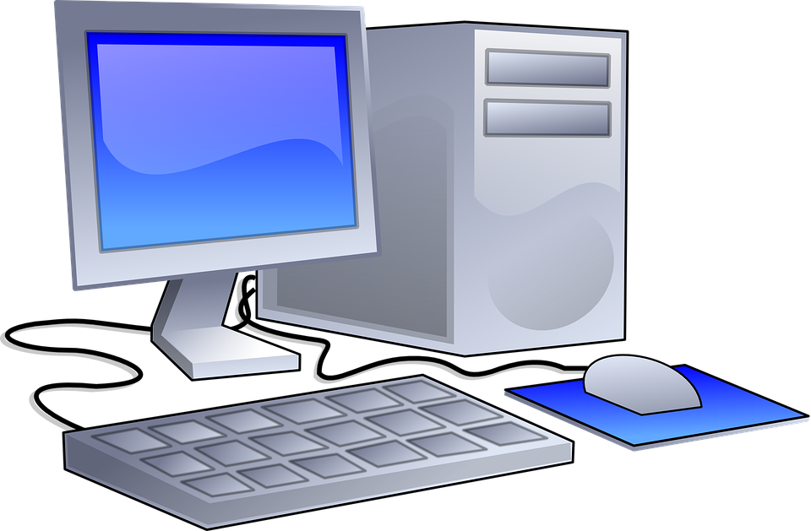
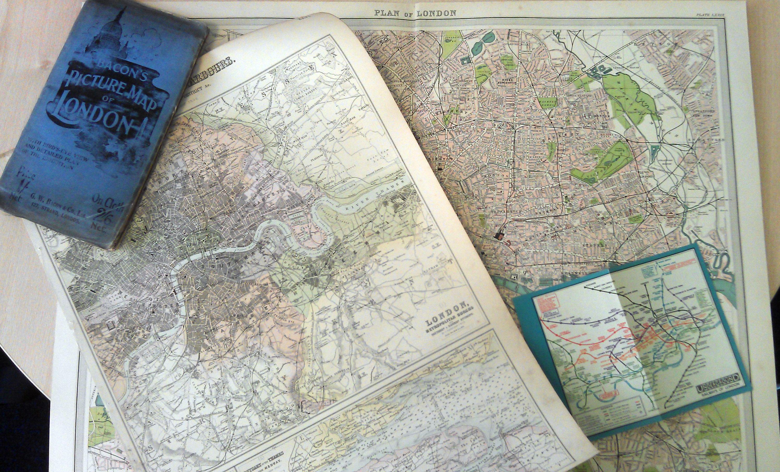
How to do it?
Paper Maps
Time-consuming
Good quality paper maps may be hard to find
Internet Resources

Slide 25

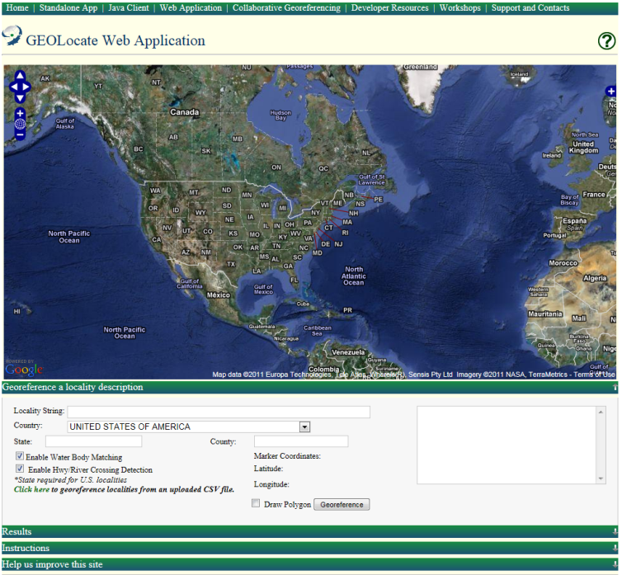
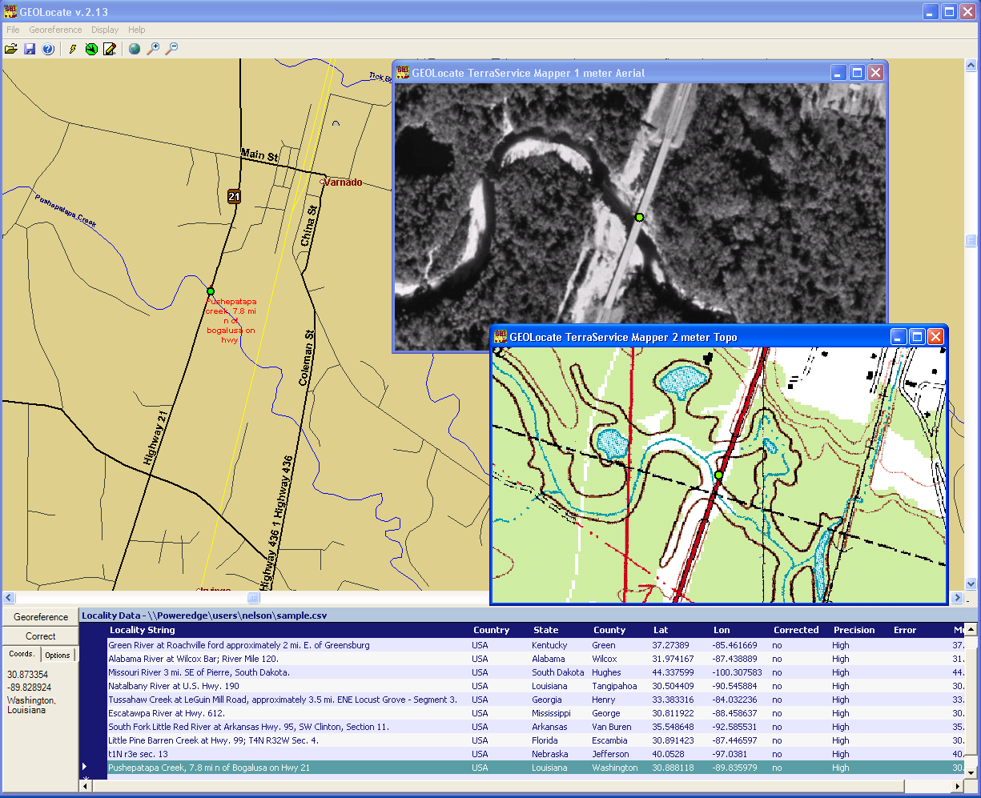
https://www.geo-locate.org/
Software services for georeferencing of natural history collection data
Automated georeferencing
Verification and correction
Multi-lingual
Interoperability
Training
Uncertainty determination
Batch processing
Collaborative georeferencing
Geographic visualization
Kml export
Notes:
You can use automated, multi-lingual

Slide 26
GeoLocate Workflow

Slide 27
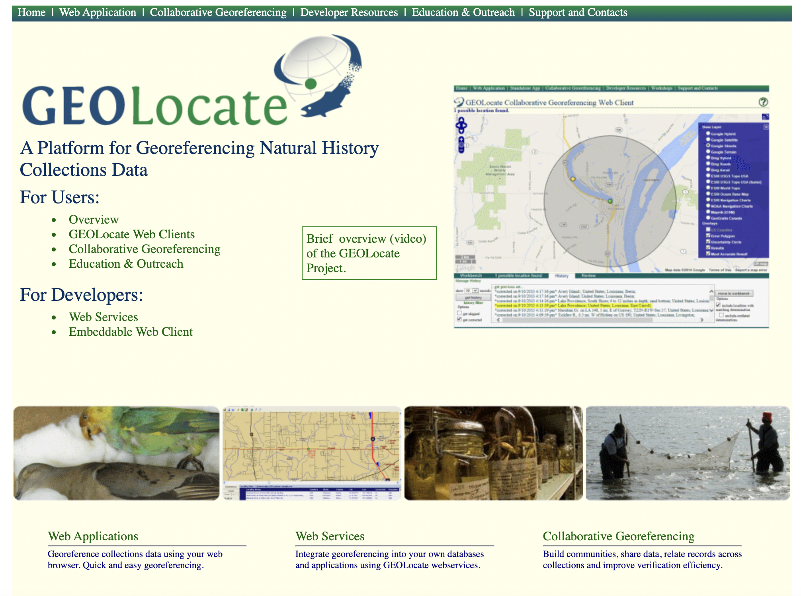
GeoLocate Workflow

Slide 28
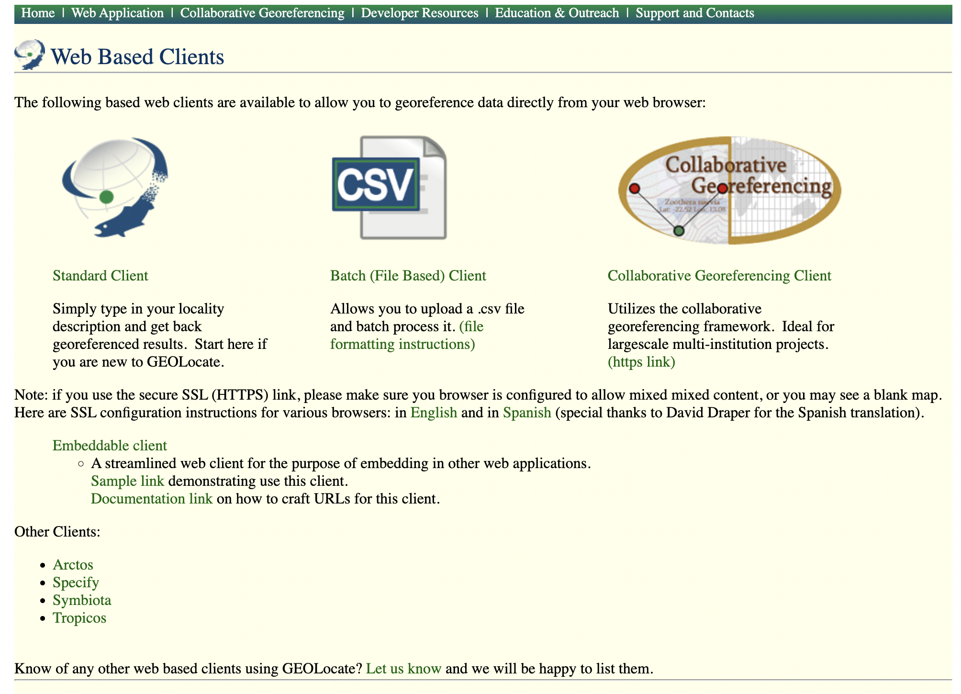
GeoLocate Workflow

Slide 29
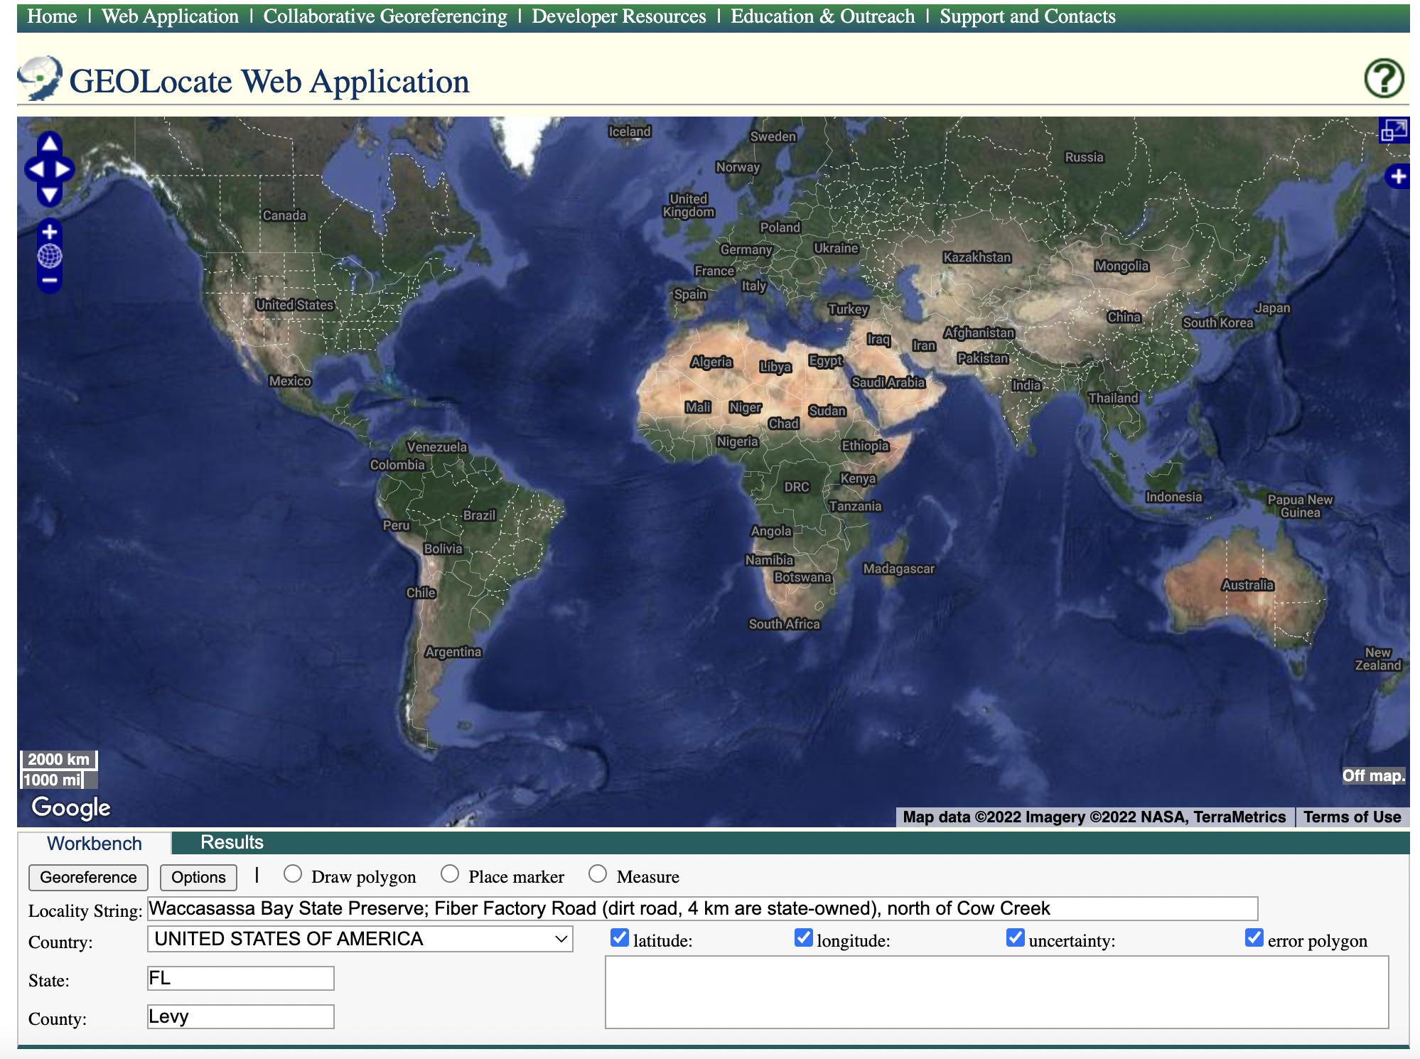
GeoLocate Workflow

Slide 30
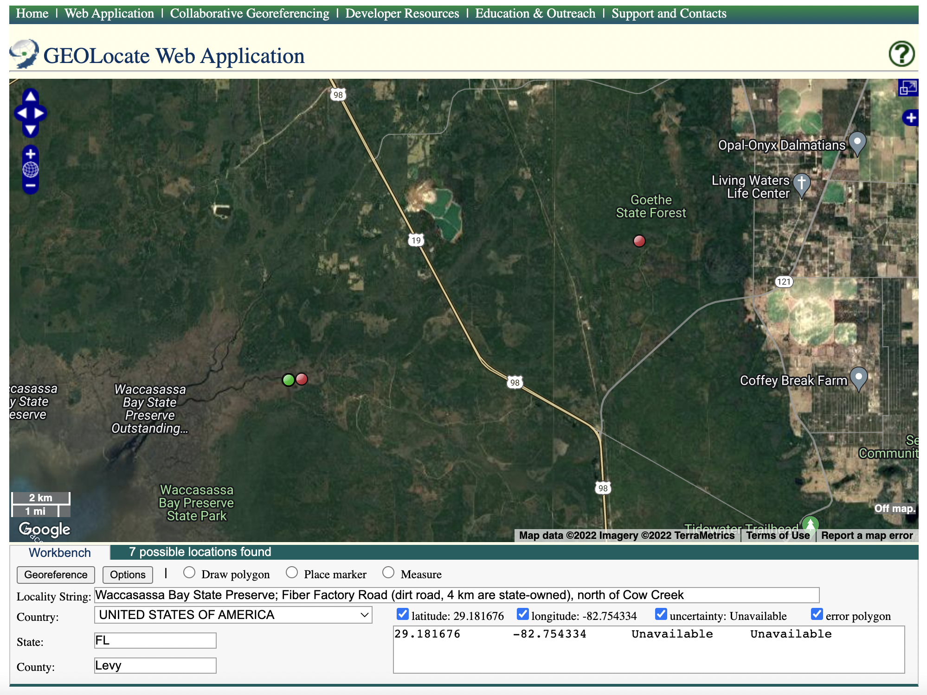
GeoLocate Workflow

Slide 31
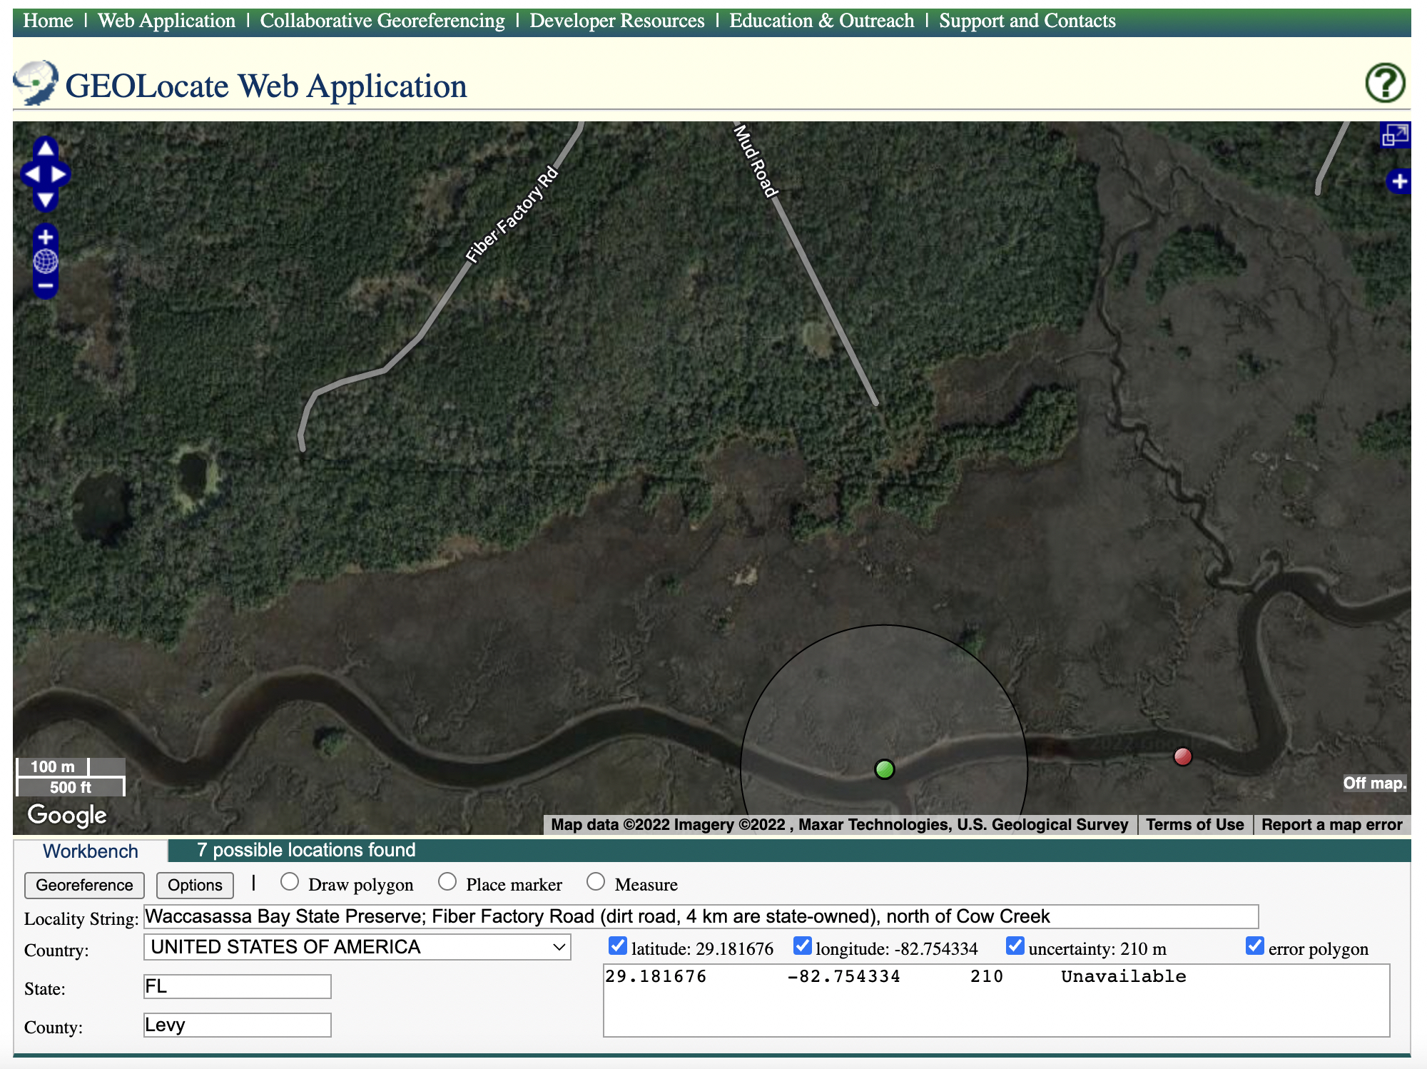

Slide 32
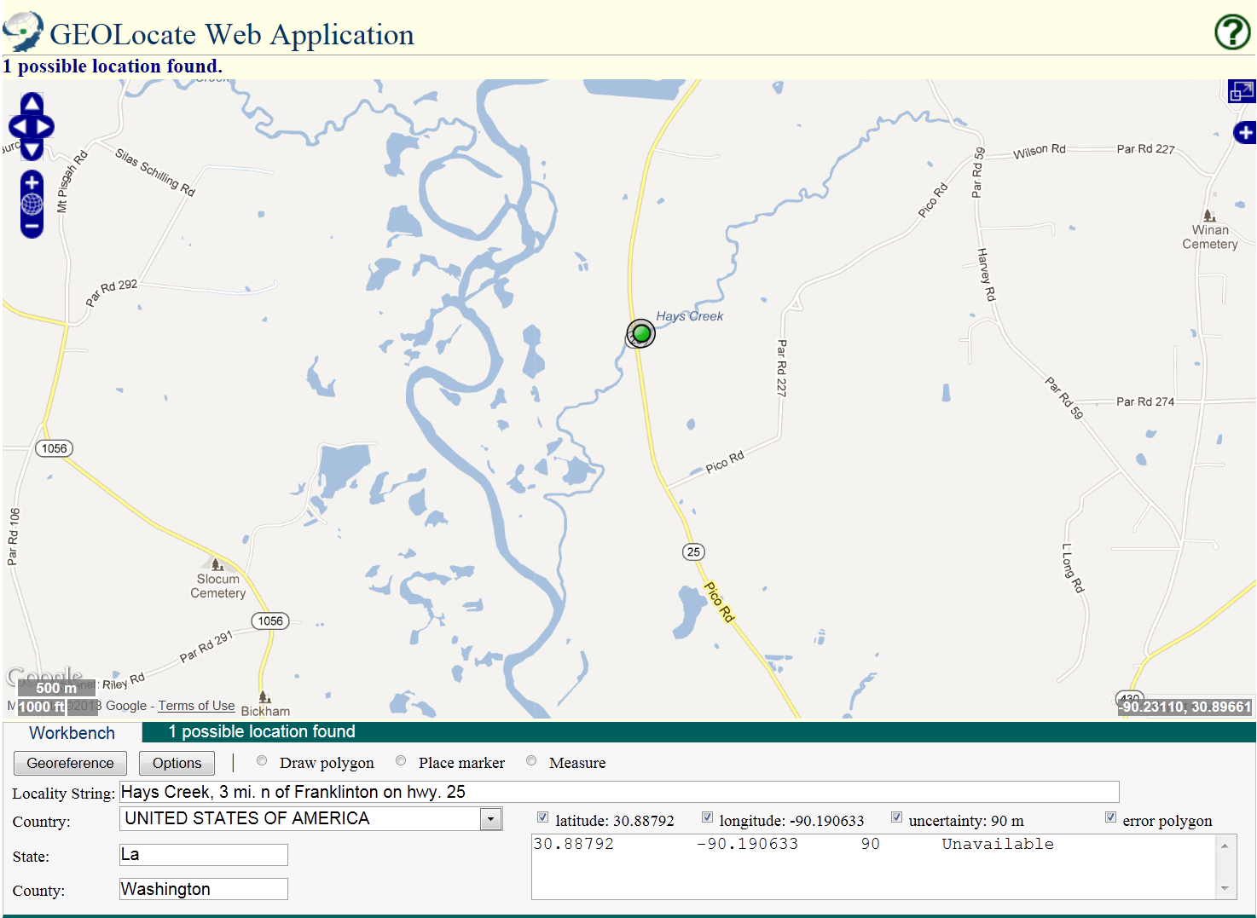
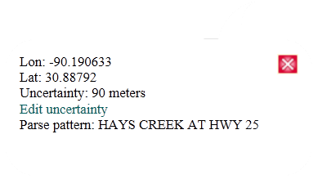

Slide 34
Notes:
World bigger with the top!
Look at different layers with + button!

Slide 36
GeoLocate Workflow

Slide 37
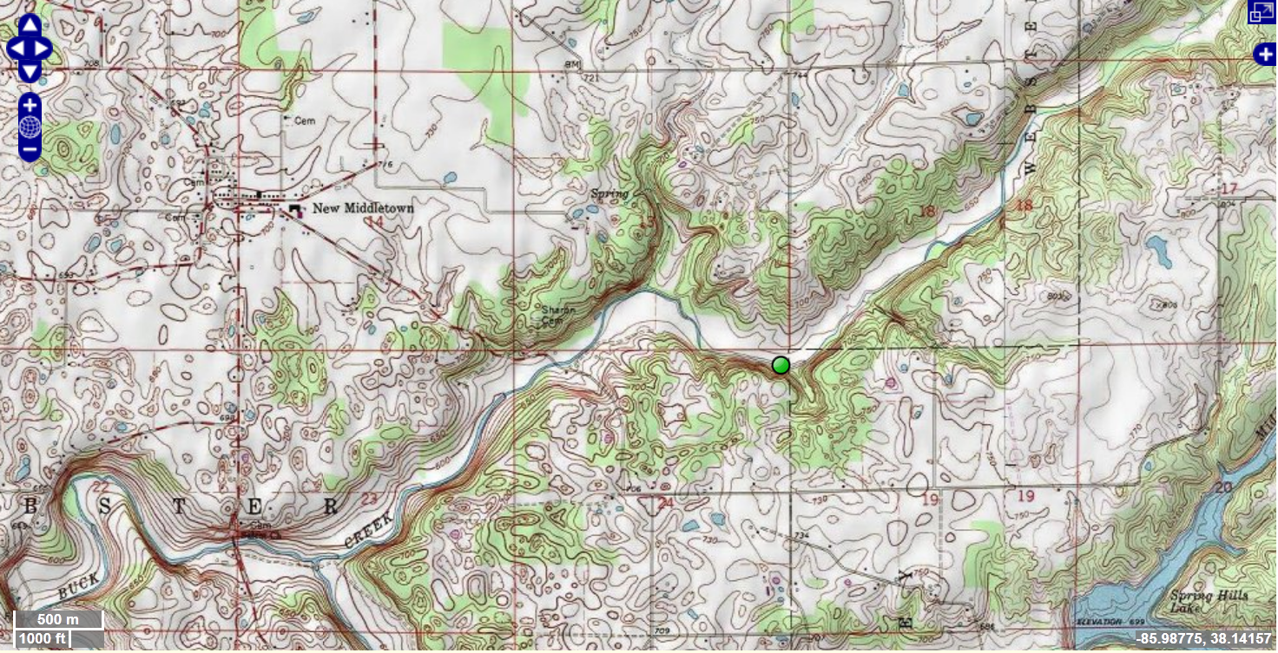
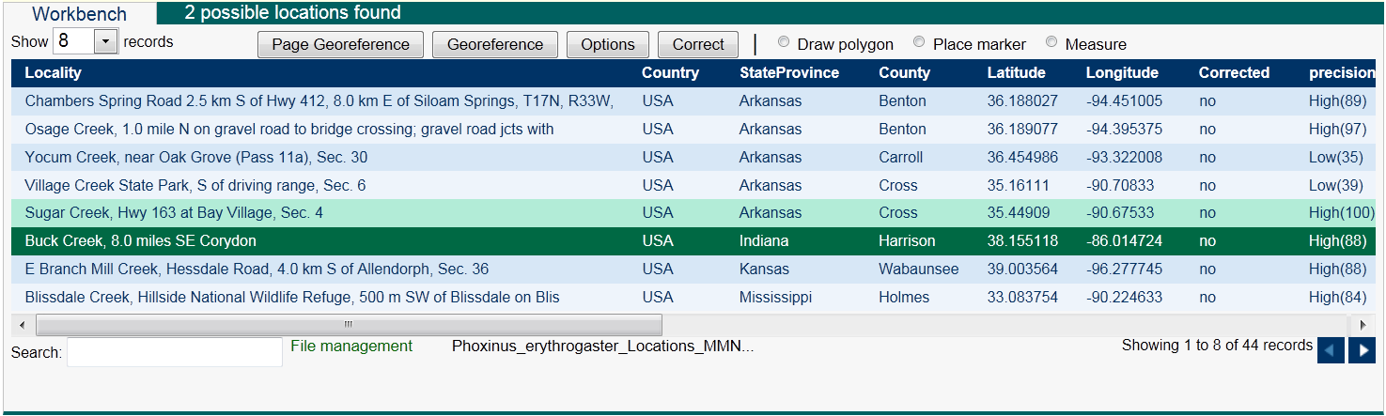
Batch Georeferencing
Notes:
Input for Batch georeferencing csv

Slide 38
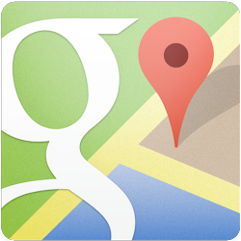
Google Maps
Search and directions
Free text search
Directions for traveling by car, bike, public transportation, or foot
Data compiled from different sources
Maps
Views: map, satellite, terrain, Google Street View
Sources of maps indicated at bottom

Slide 39
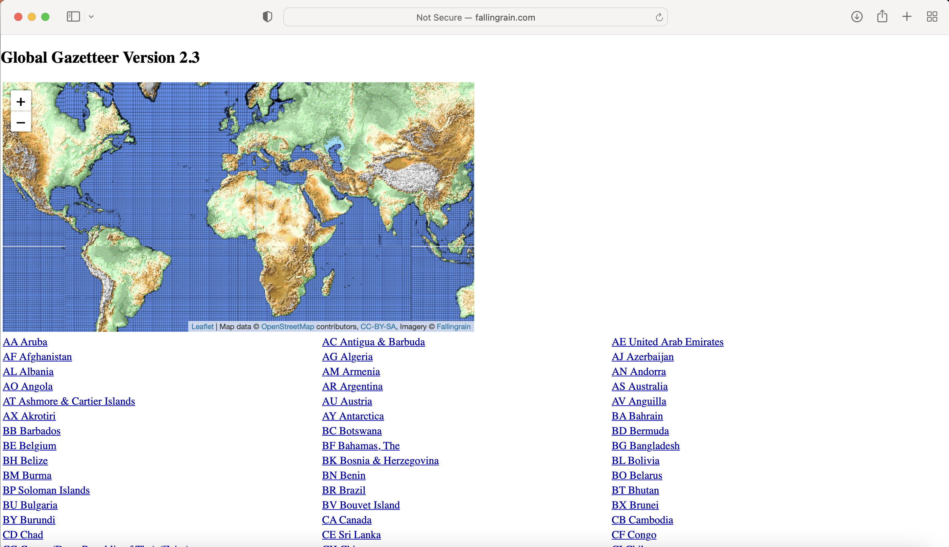
Falling Rain
Worldwide gazetteer for cities and towns
Great for hard to find localities, especially outside US
No search
Provides hierarchy, alternative names, altitude, weather information, and location of nearby towns
Example: Qaryeh-ye Gol’alam, Velayat-e Lowgar, AF
www.fallingrain.com
Notes:
Really great because the name of cities - since names often change!

Slide 40
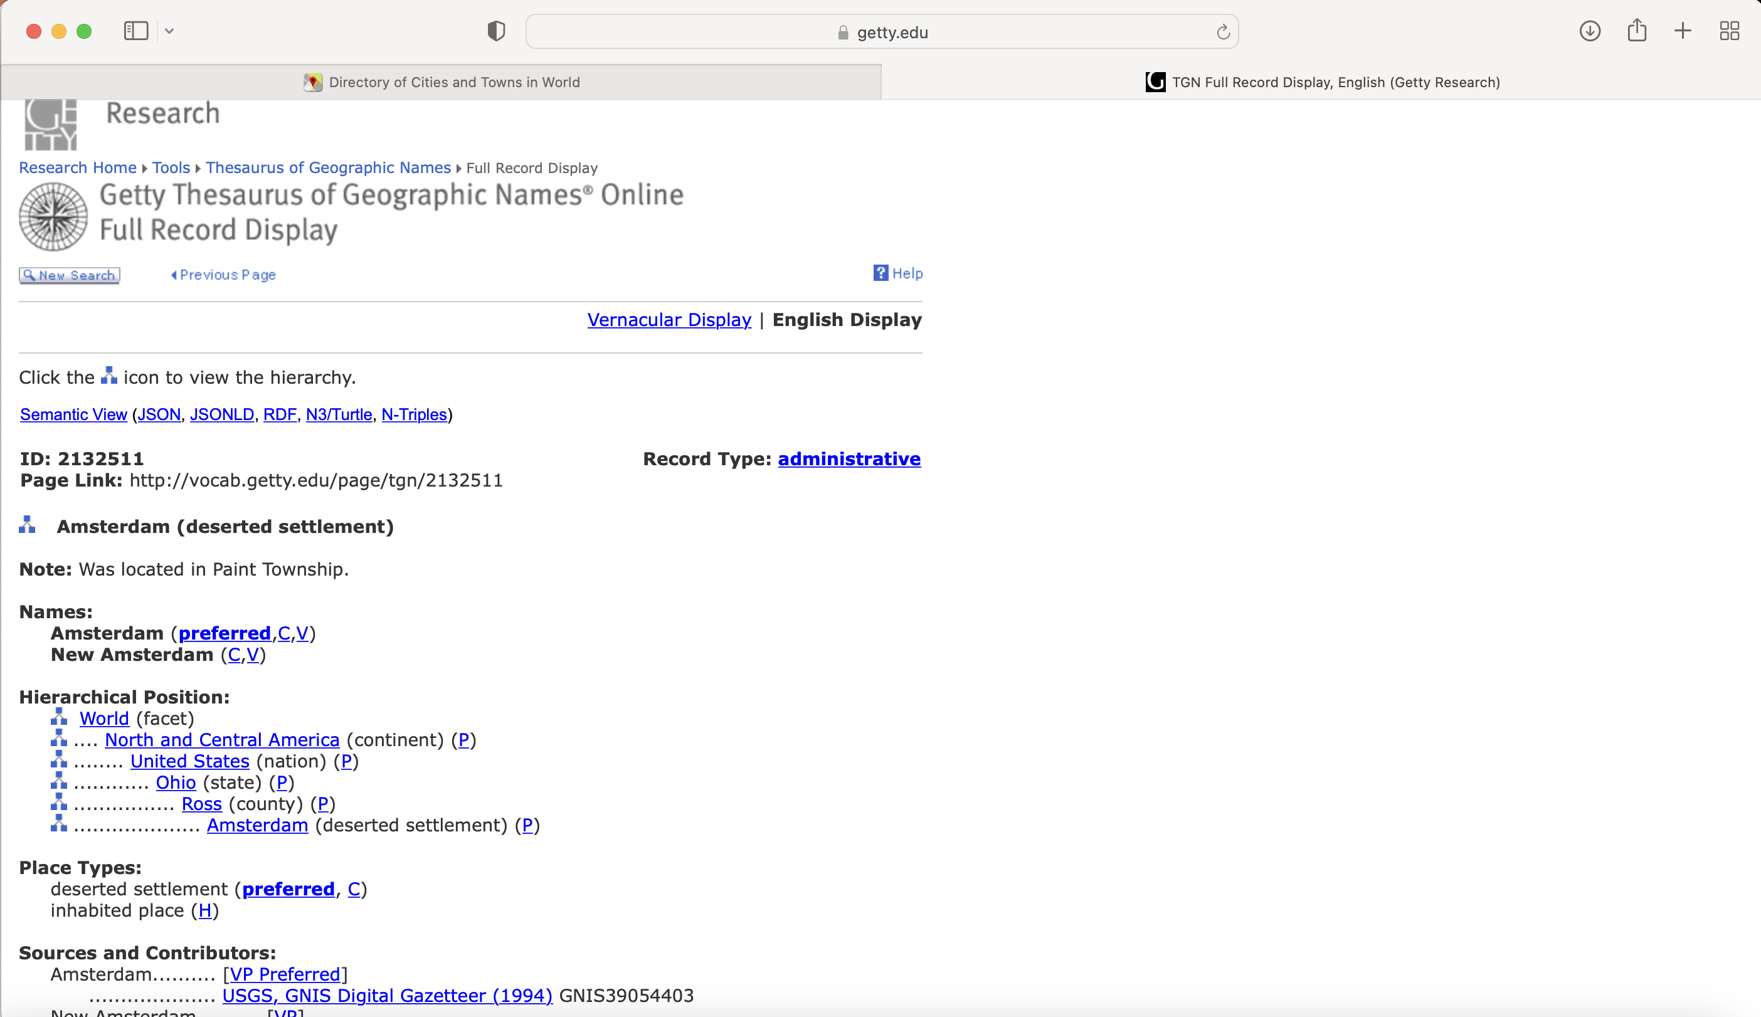
Getty Thesaurus of Geographic Names (TGN)
Worldwide gazetteer by The Getty
Useful for alternative and old names
Feature types
Geographical hierarchy
Degrees-minutes, not coordinates
Use recent name and search in Google Maps
Example: New Amsterdam, US
http://bit.ly/Getty-TGN

Slide 41
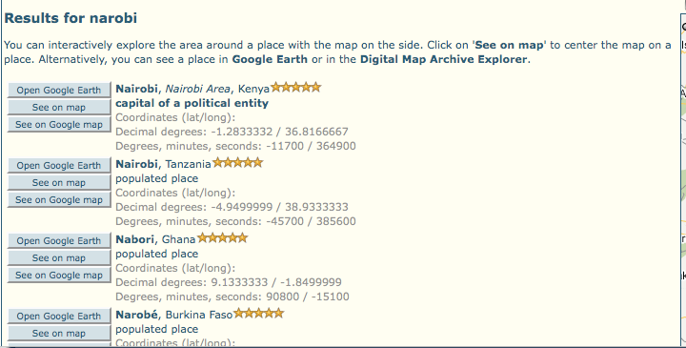
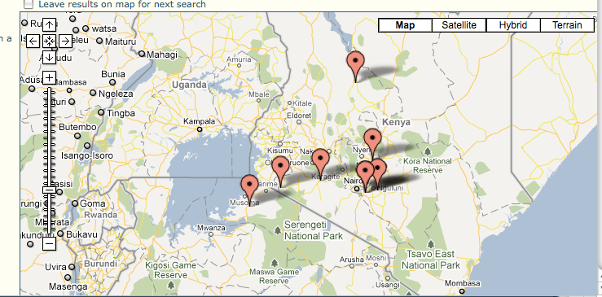
FuzzyG- JRC Fuzzy Gazetteer
Worldwide gazetteer designed for bad spelling
Critical for translating between languages
Useful for finding alternative, doubtful spelling, and old names
Feature types, by continent
Degree-minutes, not coordinates
Example: Narobi instead of Nairobi, Africa
http://dma.jrc.it/services/fuzzyg/

Slide 42
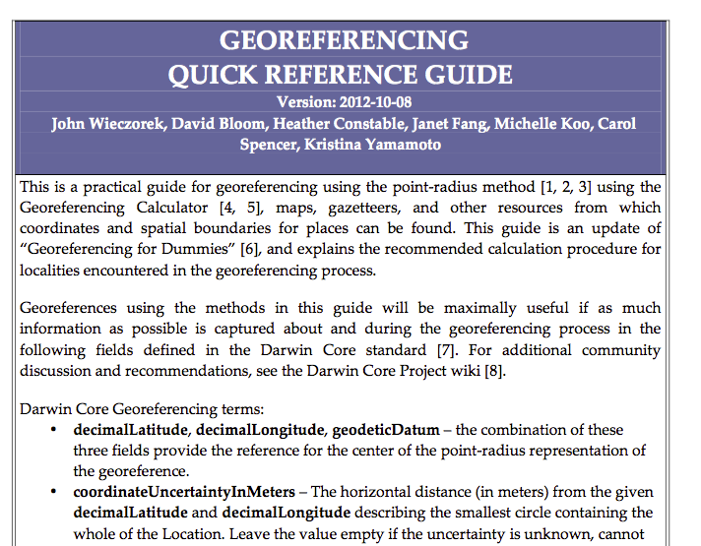
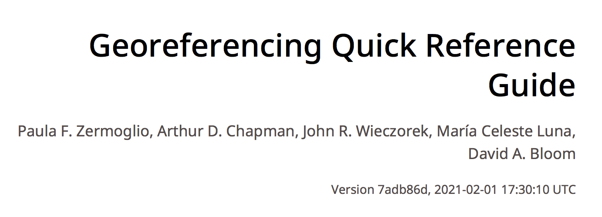
Georeferencing
Quick Reference Guide
https://docs.gbif.org/georeferencing-quick-reference-guide/1.0/en/
http://www.herpnet.org/herpnet/documents/GeoreferencingQuickGuide.pdf

Slide 43

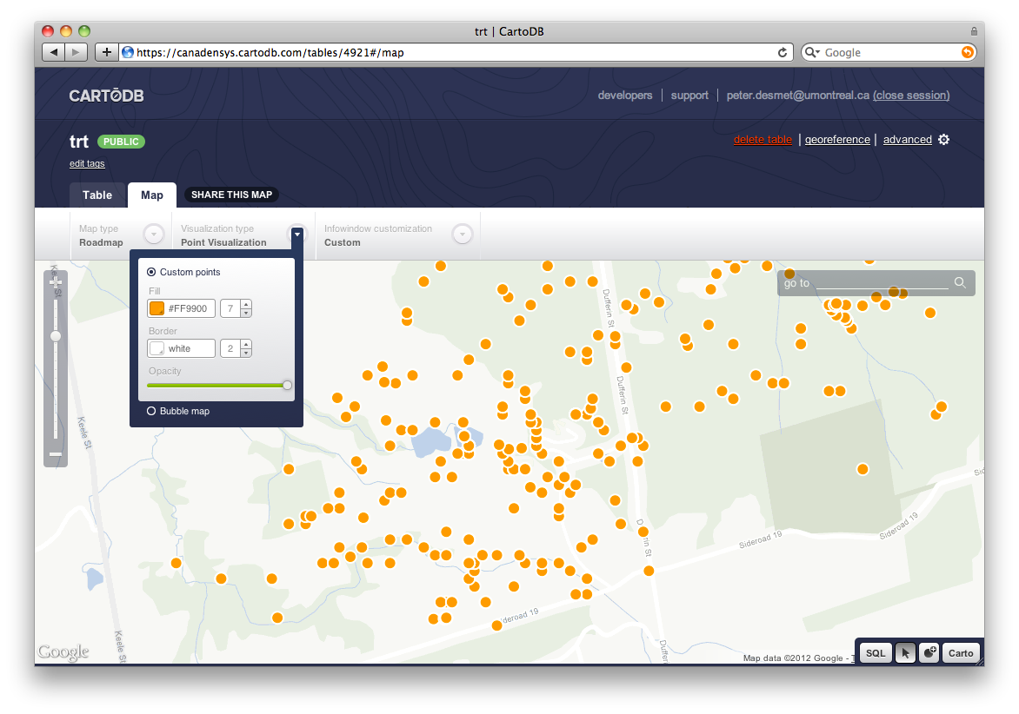
Other Tools: Visualizing Data
GPS Visualizer
Use to translate a file with coordinates into kml or a map
Carto
Online geospatial database
Drag and drop CSV upload
Easy customization of map
Share and embed map
Powerful development tools
http://www.gpsvisualizer.com/
http://carto.com

Slide 44

Links with links
https://www.idigbio.org/wiki/index.php/Georeferencing
http://herpnet.org/Gazetteer/GeorefResources.htm

Slide 45
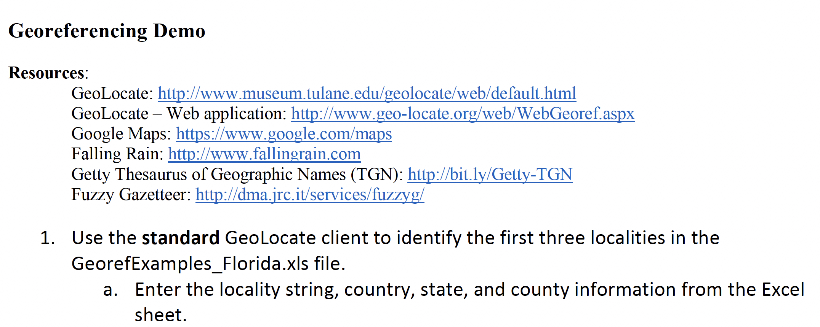
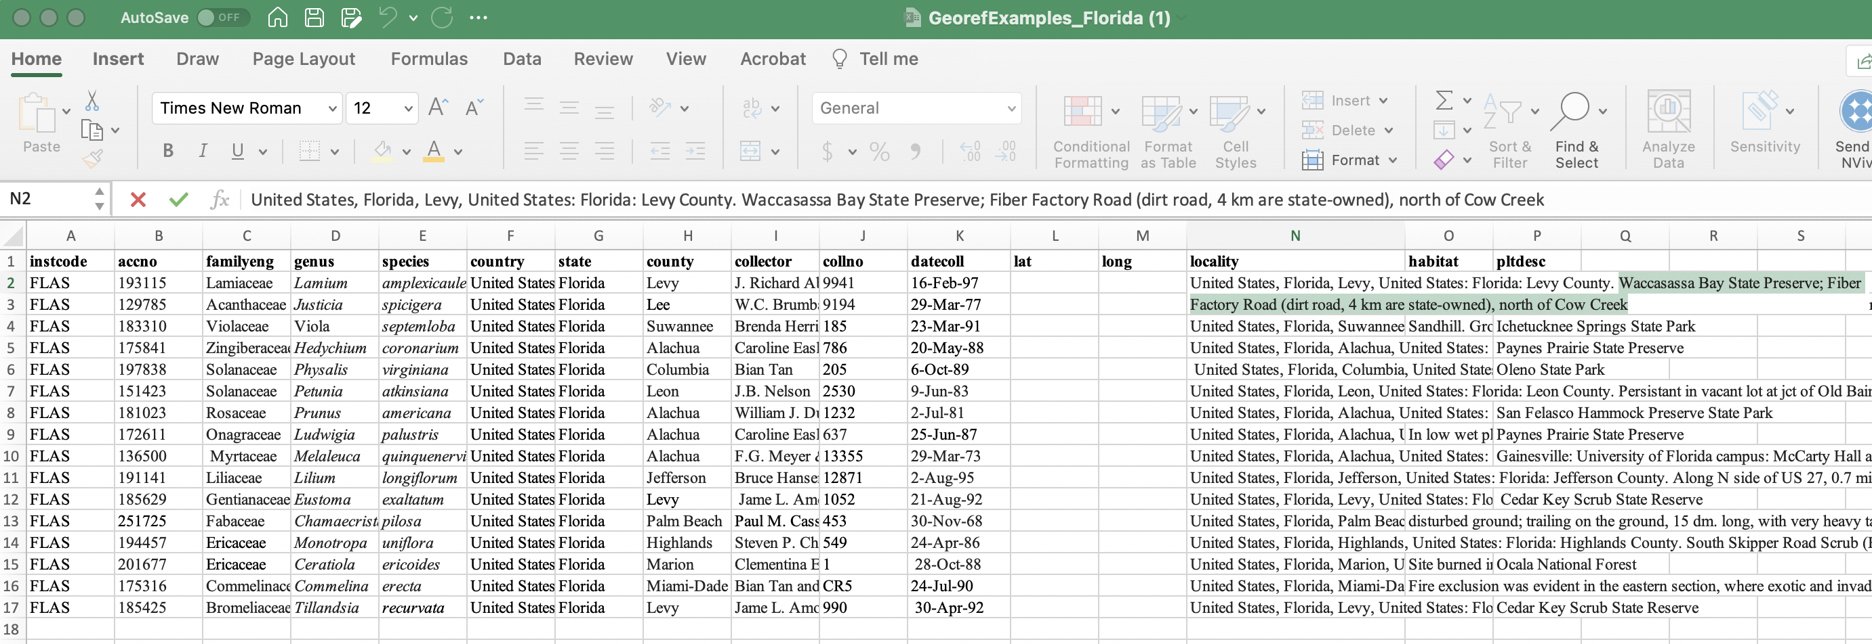
GEOLocate Practice
Instruction sheet
Excel sheet with localities

